Slide 1

Unsupervised Learning

Slide 2
Unsupervised Learning
The computer is trained with unlabeled data.
Here there’s no teacher at all, actually the computer might be able to teach you new things after it learns patterns in data, these algorithms a particularly useful in cases where the human expert doesn’t know what to look for in the data.

Slide 3
Unsupervised Learning
Family of machine learning algorithms which are mainly used in pattern detection and descriptive modeling. However, there are no output categories or labels here based on which the algorithm can try to model relationships.
These algorithms try to use techniques on the input data to mine for rules, detect patterns, and summarize and group the data points which help in deriving meaningful insights and describe the data better to the users.
The main types of unsupervised learning algorithms include Clustering algorithms and Association rule learning algorithms.

Slide 4
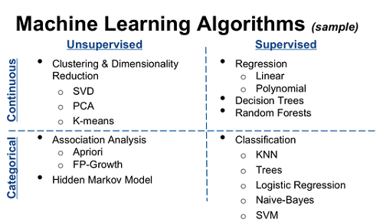

Slide 5
Common unsupervised learning approaches
Unsupervised learning models are utilized for three main tasks
—clustering, association and dimensionality reduction.

Slide 6
1. Clustering
Clustering is a data mining technique which groups unlabeled data based on their similarities or differences.
Clustering algorithms are used to process raw, unclassified data objects into groups represented by structures or patterns in the information.
Clustering algorithms can be categorized into a few types, specifically exclusive, overlapping, hierarchical, and probabilistic.

Slide 7
1.1 Exclusive and Overlapping Clustering
Exclusive clustering is a form of grouping that stipulates a data point can exist only in one cluster.
This can also be referred to as “hard” clustering.
The K-means clustering algorithm is an example of exclusive clustering.

Slide 8
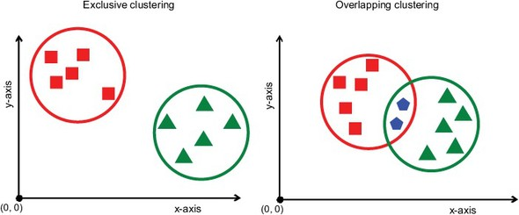
1.1 Exclusive and Overlapping Clustering
Overlapping clusters differs from exclusive clustering in that it allows data points to belong to multiple clusters with separate degrees of membership.
“Soft” or fuzzy k-means clustering is an example of overlapping clustering.

Slide 9
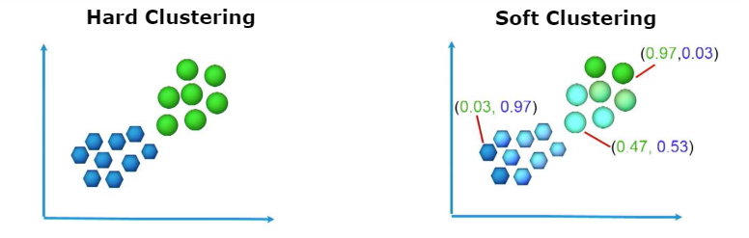
In soft clustering or fuzzy clustering, each data point can belong to multiple clusters along with its probability score or likelihood.
One of the widely used soft clustering algorithms is the Fuzzy C-means clustering (FCM) Algorithm.
https://www.geeksforgeeks.org/ml-fuzzy-clustering/

Slide 10
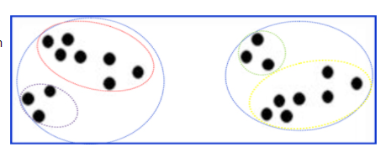
1.2 Hierarchical clustering
Hierarchical clustering, also known as hierarchical cluster analysis (HCA), is an unsupervised clustering algorithm that can be categorized in two ways; they can be agglomerative or divisive.

Slide 11
Agglomerative clustering
Agglomerative clustering is considered a “bottoms-up approach.” Its data points are isolated as separate groupings initially, and then they are merged together iteratively on the basis of similarity until one cluster has been achieved.

Slide 12
Process
How does it work?
Make each data point a single-point cluster → forms N clusters
Take the two closest data points and make them one cluster → forms N-1 clusters
Take the two closest clusters and make them one cluster → Forms N-2 clusters.
Repeat step-3 until you are left with only one cluster.

Slide 13
Agglomerative clustering

Slide 14
Four different methods are commonly used to measure similarity:
Ward’s linkage: This method states that the distance between two clusters is defined by the increase in the sum of squared after the clusters are merged.
Average linkage: This method is defined by the mean distance between two points in each cluster
Complete (or maximum) linkage: This method is defined by the maximum distance between two points in each cluster
Single (or minimum) linkage: This method is defined by the minimum distance between two points in each cluster
Euclidean distance is the most common metric used to calculate these distances; however, other metrics, such as Manhattan distance, are also cited in clustering literature.
The point of doing all this is to demonstrate the way hierarchical clustering works, it maintains a memory of how we went through this process and that memory is stored in Dendrogram.

Slide 16
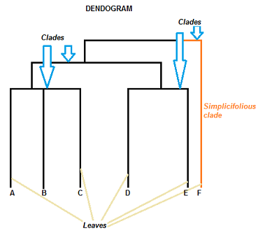
Parts of Dendrogram

Slide 17
The Clades are the branch and are arranged according to how similar (or dissimilar) they are. Clades that are close to the same height are similar to each other; clades with different heights are dissimilar — the greater the difference in height, the more dissimilarity.
Each clade has one or more leaves.
Leaves A, B, and C are more similar to each other than they are to leaves D, E, or F.
Leaves D and E are more similar to each other than they are to leaves A, B, C, or F.
Leaf F is substantially different from all of the other leaves.

Slide 18
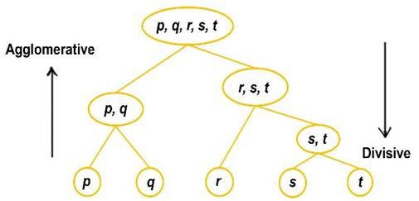
Divisive clustering
Can be defined as the opposite of agglomerative clustering; instead it takes a “top-down” approach.
In this case, a single data cluster is divided based on the differences between data points.

Slide 19
Measuring the goodness of Clusters → https://www.kdnuggets.com/2019/09/hierarchical-clustering.html
Steps to Perform Hierarchical Clustering → Read Steps to Perform Hierarchical Clustering.pdf uploaded in Week 4

Slide 20
1.3 Probabilistic clustering
A probabilistic model is an unsupervised technique that helps us solve density estimation or “soft” clustering problems.
In probabilistic clustering, data points are clustered based on the likelihood that they belong to a particular distribution.
The Gaussian Mixture Model (GMM) is the one of the most commonly used probabilistic clustering methods.

Slide 21
Association Rules
An association rule is a rule-based method for finding relationships between variables in a given dataset.
These methods are frequently used for market basket analysis, allowing companies to better understand relationships between different products.
Understanding consumption habits of customers enables businesses to develop better cross-selling strategies and recommendation engines.
Examples of this can be seen in Amazon’s “Customers Who Bought This Item Also Bought” or Spotify’s "Discover Weekly" playlist.
While there are a few different algorithms used to generate association rules, such as Apriori, Eclat, and FP-Growth, the Apriori algorithm is most widely used.

Slide 22
Apriori algorithms
Apriori algorithms have been popularized through market basket analyses, leading to different recommendation engines for music platforms and online retailers.
They are used within transactional datasets to identify frequent itemsets, or collections of items, to identify the likelihood of consuming a product given the consumption of another product.
For example, if I play Black Sabbath’s radio on Spotify, starting with their song “Orchid”, one of the other songs on this channel will likely be a Led Zeppelin song, such as “Over the Hills and Far Away.”
This is based on my prior listening habits as well as the ones of others. Apriori algorithms use a hash tree to count itemsets, navigating through the dataset in a breadth-first manner.

Slide 23
Association rules
Association rules analysis is a technique to uncover how items are associated to each other. There are three common ways to measure association.
Support
Confidence
Lift

Slide 24
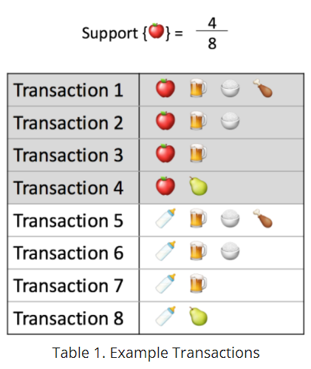
Measure 1: Support
This says how popular an itemset is, as measured by the proportion of transactions in which an itemset appears.
In Table 1 below, the support of {apple} is 4 out of 8, or 50%. Itemsets can also contain multiple items. For instance, the support of {apple, beer, rice} is 2 out of 8, or 25%.

Slide 25
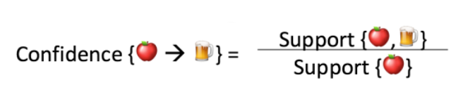
Measure 2: Confidence.
This says how likely item Y is purchased when item X is purchased, expressed as {X -> Y}. This is measured by the proportion of transactions with item X, in which item Y also appears.
In Table 1, the confidence of {apple -> beer} is 3 out of 4, or 75%.

Slide 26
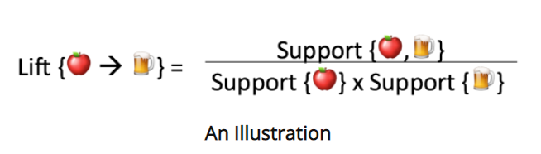
Measure 3: Lift.
This says how likely item Y is purchased when item X is purchased, while controlling for how popular item Y is.
In Table 1, the lift of {apple -> beer} is 1,which implies no association between items.
A lift value greater than 1 means that item Y is likely to be bought if item X is bought, while a value less than 1 means that item Y is unlikely to be bought if item X is bought.

Slide 27
Reading Task
Read Apriori algorithm → https://www.kdnuggets.com/2016/04/association-rules-apriori-algorithm-tutorial.html/2
For numerical example → https://www.javatpoint.com/apriori-algorithm-in-machine-learning

Slide 28
Dimensionality reduction
While more data generally yields more accurate results, it can also impact the performance of machine learning algorithms (e.g. overfitting) and it can also make it difficult to visualize datasets.
Dimensionality reduction is a technique used when the number of features, or dimensions, in a given dataset is too high.
It reduces the number of data inputs to a manageable size while also preserving the integrity of the dataset as much as possible.
It is commonly used in the preprocessing data stage, and there are a few different dimensionality reduction methods that can be used.

Slide 29
Principal component analysis
Principal component analysis (PCA) is a type of dimensionality reduction algorithm which is used to reduce redundancies and to compress datasets through feature extraction.
This method uses a linear transformation to create a new data representation, yielding a set of "principal components."
The first principal component is the direction which maximizes the variance of the dataset.
While the second principal component also finds the maximum variance in the data, it is completely uncorrelated to the first principal component, yielding a direction that is perpendicular, or orthogonal, to the first component.
This process repeats based on the number of dimensions, where a next principal component is the direction orthogonal to the prior components with the most variance.
Reading task→https://www.edureka.co/blog/principal-component-analysis/

Slide 30
Singular value decomposition
Singular value decomposition (SVD) is another dimensionality reduction approach which factorizes a matrix, A, into three, low-rank matrices.
SVD is denoted by the formula, A = USVT, where U and V are orthogonal matrices.
S is a diagonal matrix, and S values are considered singular values of matrix A.
Similar to PCA, it is commonly used to reduce noise and compress data, such as image files.
https://towardsdatascience.com/svd-8c2f72e264f

Slide 31
Autoencoders
Autoencoders leverage neural networks to compress data and then recreate a new representation of the original data’s input.
Looking at the image below, you can see that the hidden layer specifically acts as a bottleneck to compress the input layer prior to reconstructing within the output layer.
The stage from the input layer to the hidden layer is referred to as “encoding” while the stage from the hidden layer to the output layer is known as “decoding.”

Slide 32
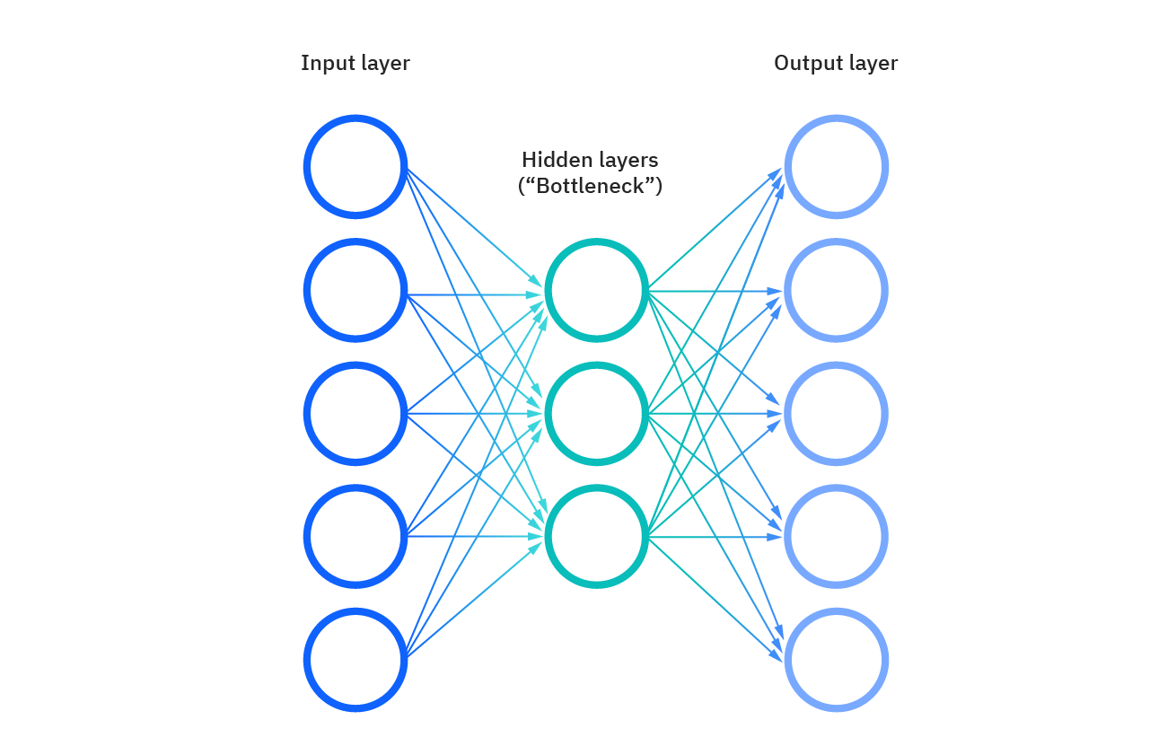

Slide 33
Reading Assignment (Optional)
Chapter 10 of
Introduction to Statistical Learning
By Gareth James, et al.

Slide 34
K Means Clustering
K Means Clustering is an unsupervised learning algorithm that will attempt to group similar clusters together in your data.
So what does a typical clustering problem look like?
Cluster Similar Documents
Cluster Customers based on Features
Market Segmentation
Identify similar physical groups

Slide 35
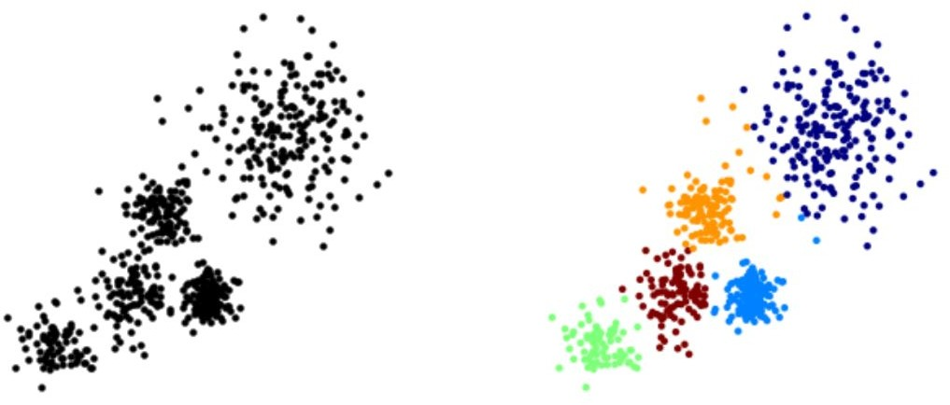
K Means Clustering
The overall goal is to divide data into distinct groups such that observations within each group are similar

Slide 36
K Means Clustering
The K Means Algorithm
Choose a number of Clusters “K”
Randomly assign each point to a cluster
Until clusters stop changing, repeat the following:
For each cluster, compute the cluster centroid by taking the mean vector of points in the cluster
Assign each data point to the cluster for which the
centroid is the closest

Slide 37
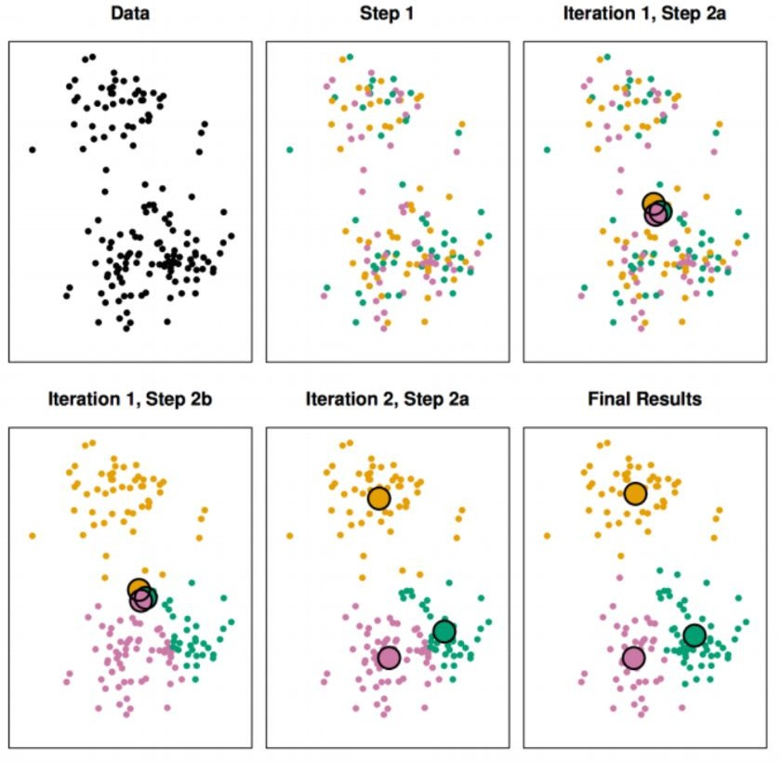
K Means Clustering

Slide 38
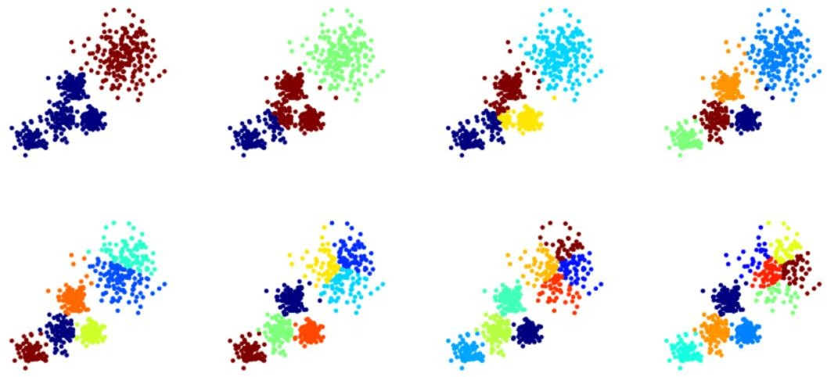
Choosing a K Value

Slide 39
Choosing a K Value
There is no easy answer for choosing a “best” K value
One way is the elbow method
First of all, compute the sum of squared error (SSE) for some values of k (for example 2, 4, 6, 8, etc.).
The SSE is defined as the sum of the squared distance between each member of the cluster and its centroid.

Slide 40
Choosing a K Value
If you plot k against the SSE, you will see that the error decreases as k gets larger; this is because when the number of clusters increases, they should be smaller, so distortion is also smaller.
The idea of the elbow method is to choose the k at which the SSE decreases abruptly.
This produces an "elbow effect" in the graph, as you can see in the following picture:

Slide 41
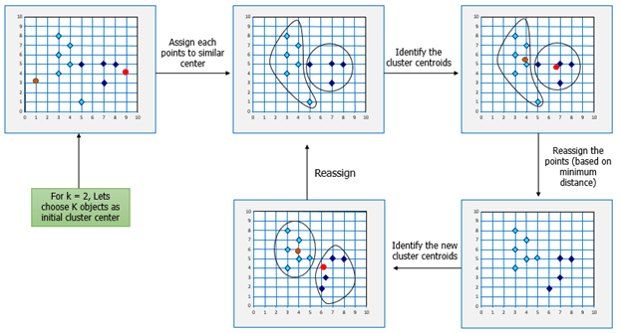

Slide 42
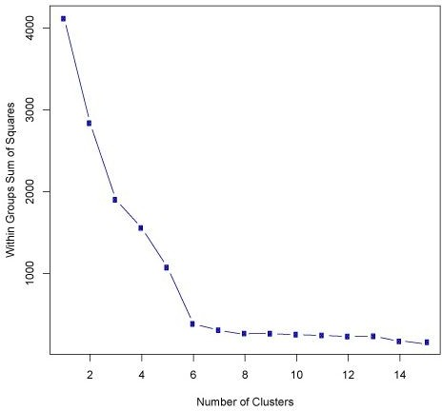
Choosing a K Value

Slide 43
Applications of Unsupervised Learning
Some of the applications of unsupervised learning are:
News Sections
Computer vision
Medical imaging
Anomaly detection
Customer personas
Recommendation Engines
Refer this link for explanation → https://www.ibm.com/cloud/learn/unsupervised-learning#toc-applicatio-omDVIJIs

Slide 44
Challenges of unsupervised learning
While unsupervised learning has many benefits, some challenges can occur when it allows machine learning models to execute without any human intervention. Some of these challenges can include:
Computational complexity due to a high volume of training data
Longer training times
Higher risk of inaccurate results
Human intervention to validate output variables
Lack of transparency into the basis on which data was clustered

Slide 45
References
https://www.ibm.com/cloud/learn/unsupervised-learning#toc-what-is-un-MP1gM75c
https://scikit-learn.org/stable/modules/clustering.html

